Slide 1
ESEE Conference 2022 – Lightning Talk
Waiting for the transition – Norms, belief and the low-carbon transition
Louison Cahen-Fourotª, Emanuele Campiglio^{b}, Louis Daumas^{c}, Michael Gregor Miess^{b,d,e} and Andrew Yardley
ª Roskilde University – Denmark
^{b} Bologna University
^{c} CIRED, France
^{d} Environment Agency Austria, Vienna
^{e} Institute for Advanced Studies, Vienna, Austria

Slide 2
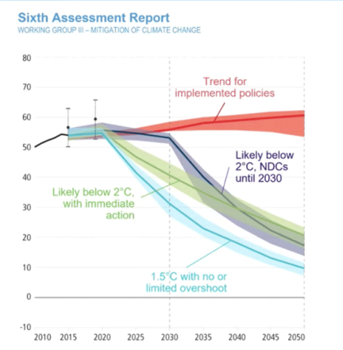
People tell stories
Collective narratives
Reaganomics
"End of history"
Green growth
Green finance
?
Decisions in radical uncertainty
Idiosyncratic beliefs
Expectation heterogeneity
Credibility of norms

Slide 3
We build a model
Sectoral model: Electricity sector
Two competing norms in the sector: policy ambition (exogenous) & adaptive (endogenous)
Stranding expectations
Investment decisions
30-year transition
(2020-2050)
Share of low-carbon capital in 2050
Heterogeneity of beliefs around these norms
Finite expectation horizon

Slide 4
Main findings
High belief dispersion can lock into an adverse norm
High belief dispersion can thwart a very ambitious policy narrative

Slide 5
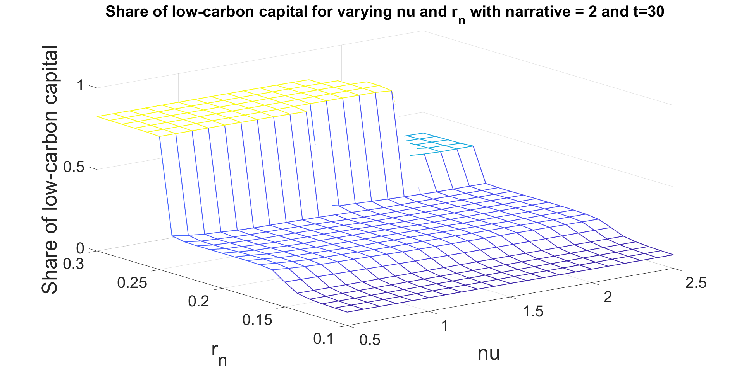
Belief dispersion interacts with norms…
Medium belief dispersion around norm
Ambition of policy norm (Penetration of low-carbon energy)
Agent Fickleness

Slide 6
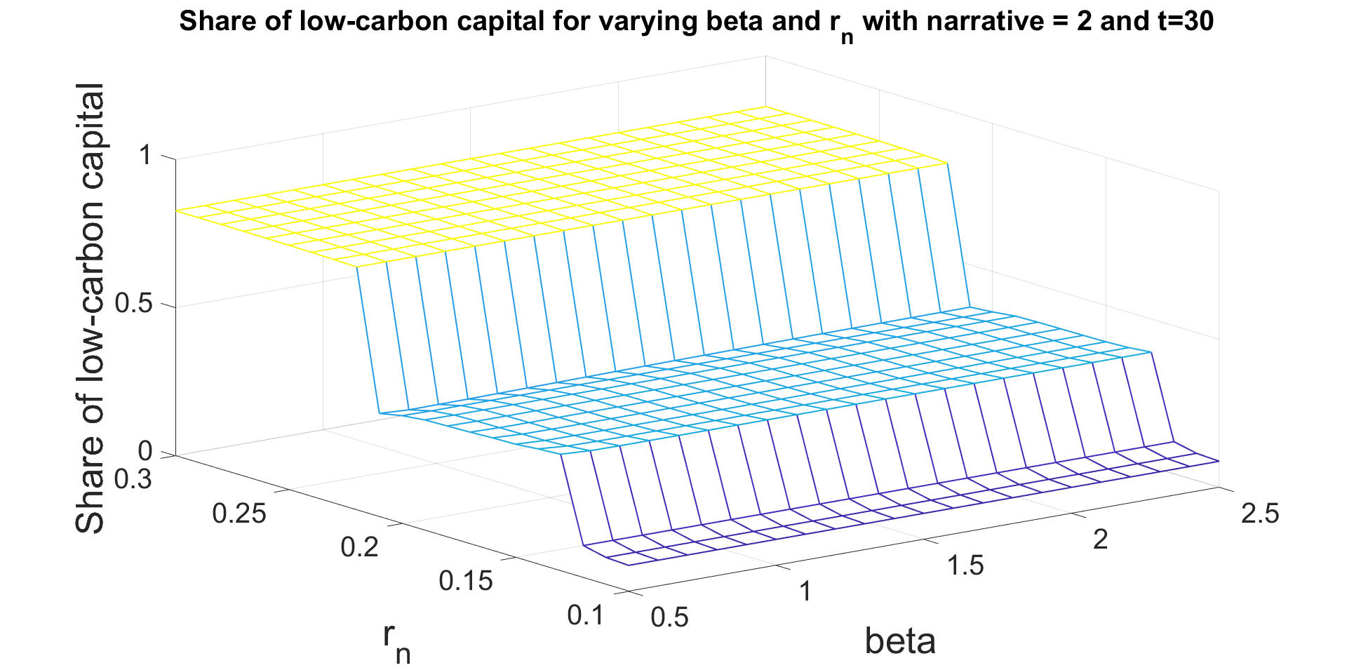
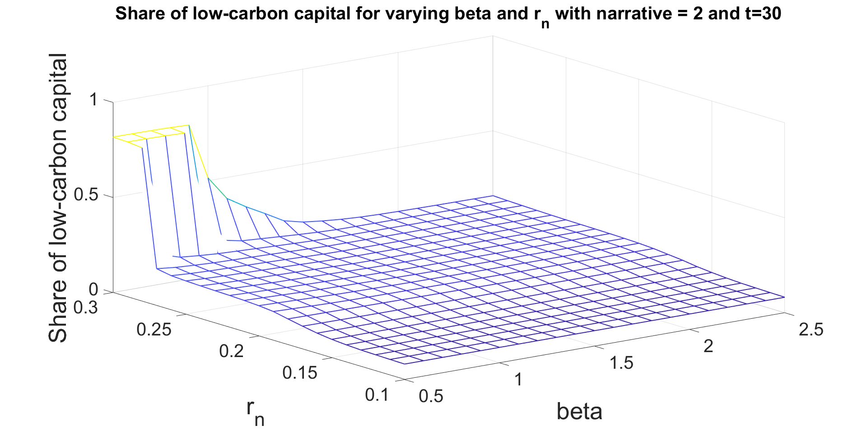
…very strongly!
Low belief dispersion around norms
High belief dispersion around norms
Ambition of policy norm (Penetration of low-carbon energy)
Agents’ fickleness
Agents’ fickleness
Ambition of policy norm (Penetration of low-carbon energy)

Slide 7
A bit more findings
A carbon tax can save the day if and only if it is credible and not subjected to belief heterogeneity
Shock to belief heterogeneity can significantly affect transition pathways

Slide 8
Thank you for attention!
louis.daumas@enpc.fr

