Slide 1
THE EUROPEAN UNION BETWEEN SUSTAINABLE DEVELOPMENT AND OPEN STRATEGIC AUTONOMY
Federico Siscaro
International Relations Officer for the Italian Customs and Monopolies Agency
PROSPECTS FOR ACTION IN THE LIGHT OF THE 2023 STRATEGIC FORESIGHT REPORT

Slide 2
The EU faces a crucial challenge in today's world: balancing the promotion of sustainable development and the pursuit of open strategic autonomy.
The EU's commitment to sustainability is inspired by the United Nations Sustainable Development Goals (SDGs) and the 2030 Agenda. Under President von der Leyen's leadership, the EU has unveiled an ambitious policy agenda dedicated to advancing sustainability, as showed by the realization of the European Green Deal and Recovery and Resilience Plans.
At the same time, due to several international crises, the notion of "Open Strategic Autonomy" has emerged. This concept combines strengthening the EU's strategic autonomy in key sectors with a commitment to multilateralism, international cooperation, and global partnerships.
The Strategic Foresight Report 2023 envisages the pursuit of sustainability in the context of the realization of open strategic autonomy. It underscores how the two goals are strictly intertwined in EU policies.

Slide 3
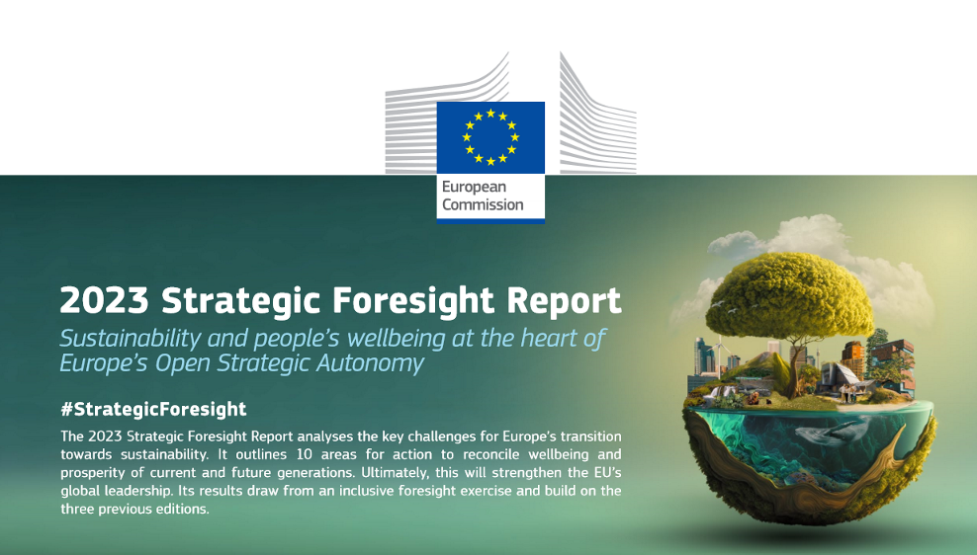
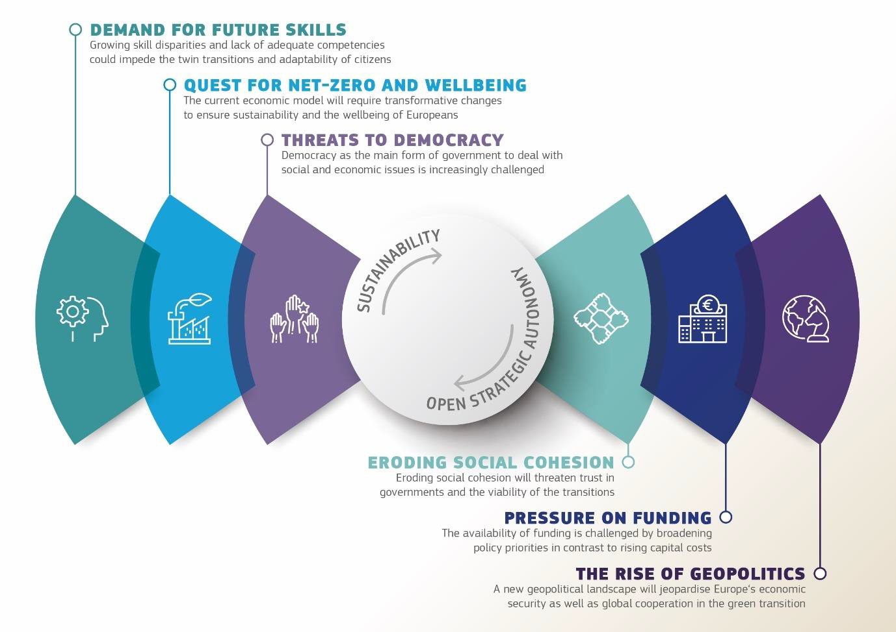
THE 2023 STRATEGIC FORESIGHT REPORT SHEDS LIGHT ON HOW SUSTAINABLE DEVELOPMENT ENHANCES EU’S RESILIENCE, INNOVATION AND GLOBAL INFLUENCE, WHICH ARE VITAL FOR ACHIEVING STRATEGIC AUTONOMY IN AN INTERDEPENDENT WORLD.
THE REPORT OUTLINES SIX KEY CHALLENGES AND TEN AREAS FOR ACTION, AMONG WHICH WE WILL FOUCUS ON TWO SPECIFIC ISSUES
1. THE REALIZATION OF SUSTAINABILITY INITIATIVES IN A SHIFTING MULTIPOLAR WORLD
2. THE PURSUIT OF A NET-ZERO ECONOMY IN THE BACKGROUND OF OPEN STRATEGIC AUTONOMY

Slide 4
THE QUEST FOR SUSTAINABILITY IN AN INCREASINGLY MULTIPOLAR WORLD
International crises and rising geopolitical tensions have ushered in a multipolar global order. The advancement of sustainable development objectives compels the empowerment of the EU's global stance through a multi-faceted and integrated approach of policymaking
A NEW TRADE STRATEGY
incorporating sustainability clauses into Free Trade Agreements
sustainability-oriented use of the Generalised Scheme of Preferences
SUPPORTING DEVELOPING COUNTRIES
the Global Gateway Strategy
CLIMATE DIPLOMACY
elevating EU's Global Leadership in sustainability standards
a more assertive action in international fora (e.g. COP27)
providing technical assistance and capacity-building to implement sustainable policies

Slide 5
ACHIEVING A NET-ZERO ECONOMY IN THE CONTEXT OF OPEN STRATEGIC AUTONOMY
Sustainability is a competitive advantage, necessitating global leadership in the net-zero industry. To achieve this, the EU must bolster industrial capabilities, enhance supply chains resilience, and leverage its influential position in the world as a major trading bloc to promote high sustainability standards.
ENHANCING INDUSTRIAL CAPACITY IN STRATEGIC GREEN TECHNOLOGIES
Massive investments in research, development, and manufacturing of net-zero technologies.
MAKING STRATEGIC SUPPLY CHAINS MORE RESILIENT
Reduce and diversify foreign dependencies in strategic sectors (i.e. semiconductors, raw materials, batteries)
PROMOTING MARKET FAIRNESS AND RESPONSIBLE BUSINESS PRACTICES
Embedding human rights and environmental concerns into corporate practices and governance.
Coordinated measures: European Green Deal Industrial Plan, Net Zero Industry Act, Critical Raw Materials Act.
Forcing trading partners to adopt similar green policies.
Carbon Border Adjustment Mechanism (CBAM); Deforestation Regulation, Directive on corporate sustainability
Economic security strategy to assess future dependencies and maintain autonomy.
Importance of preserving collaboration and promoting industrial cooperation agreements (TTC).
transformation from a net-zero technology importer to a manufacturer.

Slide 6
BALANCING SUSTAINABILITY AND STRATEGIC AUTONOMY
Overall, this presentation explores the intersection of sustainable development and strategic autonomy
Achieving sustainability means combine it with the EU’s open strategic autonomy, integrating both into the spectrum of EU policies
Key areas of action include strengthening the EU's global presence and reinforcing the Single Market for a net-zero economy
If we are to achieve the sustainability transition, it will be crucial in the upcoming future to place sustainability at the heart of the EU’s open strategic autonomy, so as to deliver on a triple promise: ‘a healthy planet and thriving environment; economic growth that is decoupled from resource use and environmental degradation; and an assurance that no person or place will be left behind’

Slide 7
THANK YOU FOR YOUR ATTENTION
Federico Siscaro
International Relations Officer for the Italian Customs and Monopolies Agency

