Slide 1
AfCFTA – Sustainable Development and Corporate Responsibility
Robert Lodde
University of Münster, Germany
IMPACCT
Notes:
Logo

Slide 2
Overview
Introduction to AfCFTA
Challenges for Trade in Africa
Sustainable Development Goals
Problems in Africa
Resource Curse
Multinational Enterprises
Small and Medium Enterprises
Informal Trade
Outlook

Slide 3

1. AfCFTA
African Continental Free Trade Agreement (AfCFTA) signed 2018
Trading officially started 2021
First step towards a single market and customs union, comparable to the European Union
Vision 2063
Parts still under negotiation

Slide 4
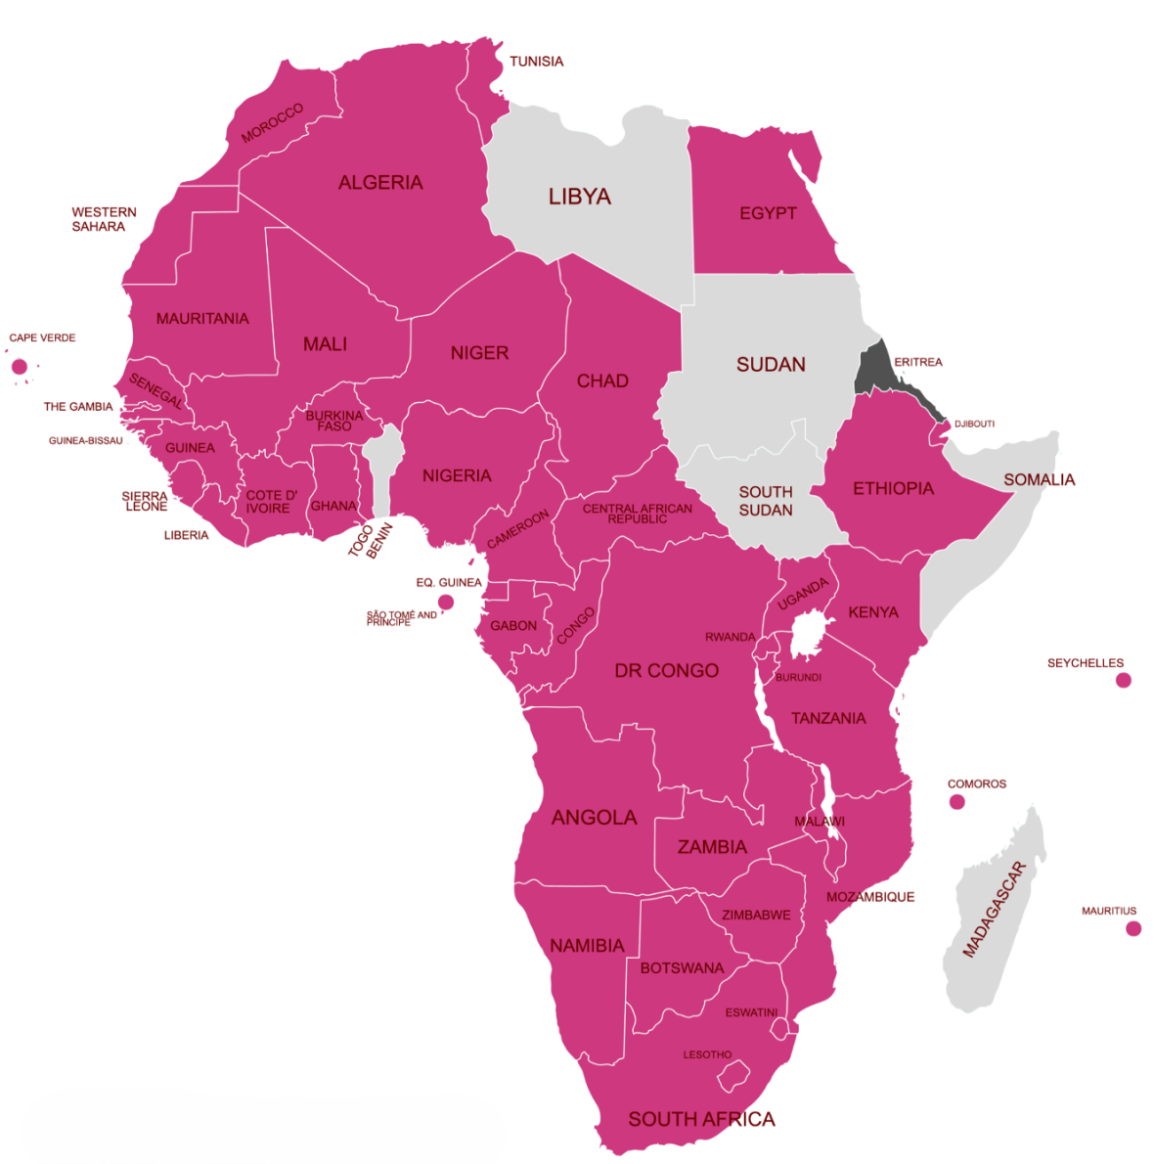
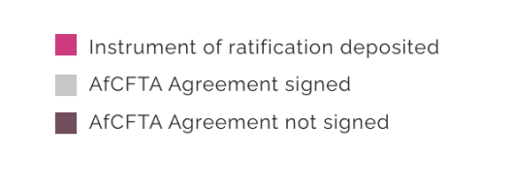


Slide 5
1. Aims of AfCFTA
Largest free trade agreement by number of member states, people and geographic size
Creation of a single market for goods, services ➔ facilitated by movement of persons
$ 450 billion boost in Africa
30 million people out of poverty
Common GDP of app. $ 3.4 trillion
Notes:
possibile

Slide 6
1. Effects of AfCFTA
African Continental Free Trade Agreement (AfCFTA) elevates intra-African trade
Importation between African countries enhanced
Establishing dispute settlement system
Protocols on Trade in Services, Investments, Copyright
Notes:
Disputes so far low of African States in similar courts
Wide range of protocols

Slide 7
1. Effects of AfCFTA - Instruments
Elimination of tariffs for products originating in Africa
Reduction of non-tariff barriers to trade (NTBs)
Enhancing movement of goods
Implementation of committees to fight trade barriers
Digitalization of customs

Slide 8
Overview
Introduction to AfCFTA
Challenges for Trade in Africa
Sustainable Development Goals
Problems in Africa
Resource Curse
Multinational Enterprises
Small and Medium Enterprises
Informal Trade
Outlook

Slide 9
2. Importing to Africa - Challenges
Non-tariff barriers to trade (NTB)
In detail
  Lack of accessibility of official documents
  Huge amount of documents required
  Tax exemptions are a long process with high administrative burden
  Administrative burden regarding medicine

Slide 10

2. Challenges to AfCFTA
Parts of AfCFTA still under negotiation
Implementation through member states varies
  Political will necessary
  NTB sub committees already work in some states
  Other states have not begun implementation
Trading through AfCFTA just started, start-up difficulties
  AfCFTA Guided Trade Initiative
  Pilot phase of AfCFTA
  Tariff barriers

Slide 11
Overview
Introduction to AfCFTA
Challenges for Trade in Africa
Sustainable Development Goals
Problems in Africa
Resource Curse
Multinational Enterprises
Small and Medium Enterprises
Informal Trade
Outlook

Slide 12
3. Sustainable Development and Corporate Responsibility
UN has 17 Sustainable Development Goals
Goal No. 1: No poverty
AfCFTA an economic agreement, can help reach this goal
Other goals achievable through economic growth
  Directly:
    food, healthcare
  Indirectly:
    Gender equality, wealth distribution
Notes:
No poverty is arguably the most difficult aim to achieve
As AfCFTA is an economic agreement, it is poised to especially achieve this goal
Richer people live longer, because they are able to invest into their healt, take time for doctors visits, etc.
Richer household means more time for both partners to edcuate or work (washmashine)

Slide 13
Overview
Introduction to AfCFTA
Challenges for Trade in Africa
Sustainable Development Goals
Problems in Africa
Resource Curse
Multinational Enterprises
Small and Medium Enterprises
Informal Trade
Outlook

Slide 14
4. Problems in Africa
Instability
Weak governments, weak institutions, strong executive
Economic deficits
Resource Curse
Poor intra-African trading
Deficits in infrastructure
However: improvements in quality of life
Notes:
Problems are many
Cause of them as well, coloialism, exploitation of ressources without investment, etc.

Slide 15
Overview
Introduction to AfCFTA
Challenges for Trade in Africa
Sustainable Development Goals
Problems in Africa
Resource Curse
Multinational Enterprises
Small and Medium Enterprises
Informal Trade
Outlook

Slide 16
5. Resource Curse? – Political
Resource rich countries
  are often quite poor
  develop slower, are more corrupt and more oppressive than other developing nations
  are less stable, economically as well as politically
Inequal distribution of wealth
Misuse by political elites, raises the value of being in power
Notes:
(Sachs, J. D., & Warner, A. M. (2001). The curse of natural resources. European Economic Review, 45(4–6), 827–838 )

Slide 17
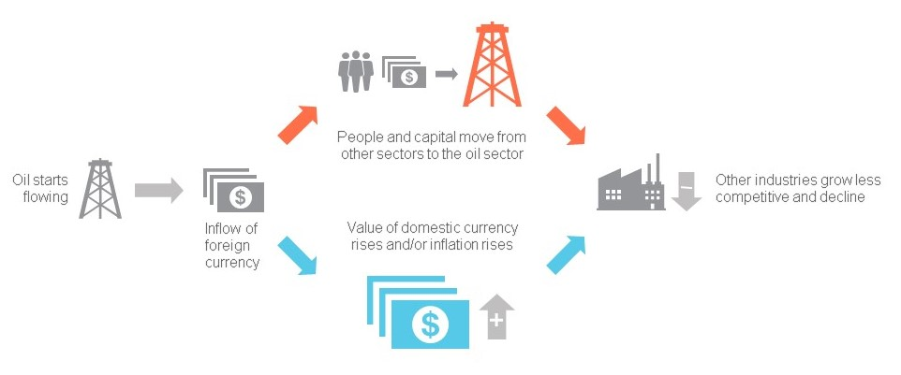
5. Resource Curse? – Economical
National Resource Governance Institute

Slide 18
5. Ressource Curse? – Economical
Increase in exportation of resources leads to decrease of other economics
Decrease of financial value (dutch disease)
Resource boom results in over-extraction rather than efficient extraction

Slide 19
5. Resource Curse – Causality or Correlation?
Chicken – egg problematic / uovo – gallina
Research by World Bank suggests that resource rich countries have worse economic framework
The worse the framework the higher the percentage of population under the poverty line
Colonialism -> exploitation without investments
Resource rich countries more colonialised
Notes:
provides more resources for the political class to influence election outcomes, and essentially results in resource misallocation with the resultant impact of underdevelopment relative to resource endowment.
some resource rich countries make ist esp. difficult to do business, these are the poorest
Alexeev, M., & Conrad, R. (2011). The natural resource curse and economic transition. Economic Systems, 35(4), 445–461; Natural Resources, Sustainable Entrepreneurship, and Poverty Reduction in Resource-Rich African Countries: The Missing Link; OLAGBOYE ET AL., 101-118

Slide 20
5. Resource Curse – Possible Solutions
Sustainable development high importance
Transparency especially important -> contracts regarding exploitation of natural resources
Transparent and democratic states profit from resources, e.g. Botswana
Diversification of industries, poverty reduction through entrepreneurship
Use of funds in public interest, like education

Slide 21
Overview
Introduction to AfCFTA
Challenges for Trade in Africa
Sustainable Development Goals
Problems in Africa
Resource Curse
Multinational Enterprises
Small and Medium Enterprises
Informal Trade
Outlook

Slide 22
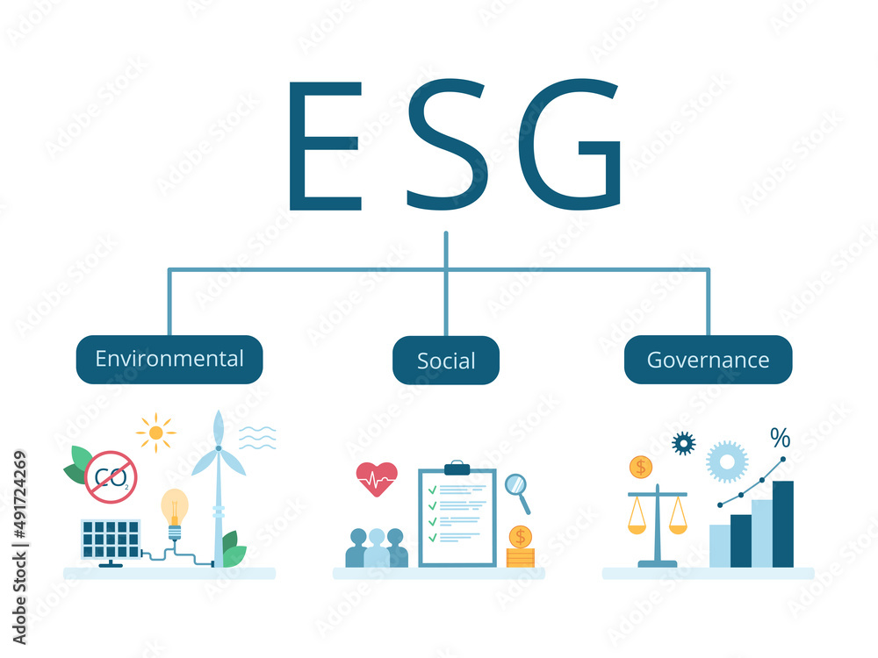
6. Multinational Enterprises and SDG
Private sector plays important role in achieving SDG
High expectations, lack of fulfillment
Firms are focused on their field of business
Difficult to balance economic growth and environmental protection
Notes:
Large funding gap in SDG programs of MNE, awareness but not implementation
Filatotchev, I., & Stahl, G. K. (2015). Towards transnational CSR: Corporate social responsibility approaches and governance solutions for multinational corporations. Organizational Dynamics, 44(2), 121–129
Focus on field of business leads to more social development in fields like waste management, recycling, job-focused education, but also to sum zero their CO2
Selfreporting, external pressure
la società non esiste per distribuire dividendi a lorsignori, ma per far andare i battelli sul Reno

Slide 23
6. Multinational Enterprises and SDG
Cooperation with government increases SDG, e.g. South Africa
However: too much regulation decreases success
Often too few communication between private and public sector
Good governance leads to achieving more goals

Slide 24
Overview
Introduction to AfCFTA
Challenges for Trade in Africa
Sustainable Development Goals
Problems in Africa
Resource Curse
Multinational Enterprises
Small and Medium Enterprises
Informal Trade
Outlook

Slide 25
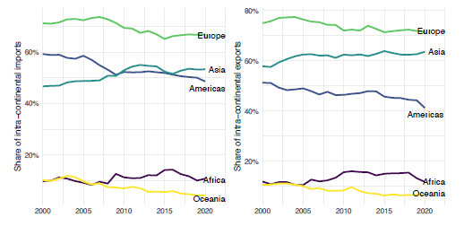
IfW Kiel, Effects of the AfCFTA for German and European Companies

Slide 26
7. AfCFTA – Inclusive Growth?
Economic growth in Africa remains high since 2000, poverty rate sinking
But: Widening income gap
Intra-African trade very low, informal
Higher intra-African trade benefits small and medium enterprises
These enterprises lead to growing middle class

Slide 27
Overview
Introduction to AfCFTA
Challenges for Trade in Africa
Sustainable Development Goals
Problems in Africa
Resource Curse
Multinational Enterprises
Small and Medium Enterprises
Informal Trade
Outlook

Slide 28
8. Informal Trade
High percentage of intra-African trade is informal
High percentage of informal traders are women
Informal trade can help alleviate people out of poverty
Informal trade results mostly from bureaucratic border crossing
Difficulty to receive documents, long waiting lines, overcharging of duties
Informal traders are more vulnerable
Governments loose revenues
Notes:
Informal trade: trade that is not formalised through agreements or customs, no statistically grapsed, e.g. people, who just go across the border to sell their products
30 % of trade in Africa
70 % of traders women “Formalization of informal trade in Africa, UN”
Does not mean illegal, is not per se bad
Grey area of activities -> Informal traders need to bribe more

Slide 29
Overview
Introduction to AfCFTA
Challenges for Trade in Africa
Sustainable Development Goals
Problems in Africa
Resource Curse
Multinational Enterprises
Small and Medium Enterprises
Informal Trade
Outlook

Slide 30
9. Outlook
AfCFTA leads to higher standardization of practices
Digitalization of customs
Single Window
Reduction of formalities
More efficient customs offices
Formalization of trade leads to more economic growth, less corruption, higher standard of life
Notes:
Ethiopian single window impressive

Slide 31
9. Outlook
AfCFTA investment protocol creates the legal framework for intra-African investments
High level of environmental, labor and consumer protection
Investments obliges members to ensure investors comply with standards
Sets-up agency to assist
Only limited effect, intra-African investment is low compared to investment from outside Africa
Notes:
Ratification still ongoing

Slide 32
Summary
Sustainable Development facilitated through AfCFTA
improving market access -> small and medium-sized enterprises (SMEs) and start-ups can grow and develop
Formalization of informal trade
Economic stability
Intra-African trade
Notes:
and creating a larger internal market, small and medium-sized enterprises (SMEs) and start-ups can grow and develop. This contributes to job creation and economic stability

Slide 33

Thank you for your attention
Robert Lodde robert.lodde@uni-muenster-customs.org
University of Münster, Germany
IMPACCT

