Slide 1
IN-EULALIA
Innovative and Inclusive
Instruments for
European Latin
Linguistic Assessment
UNIBO Team
Dipartimento di Filologia Classica e Italianistica FICLIT

Slide 2
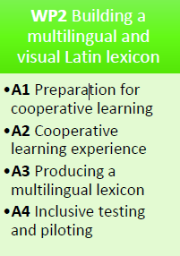
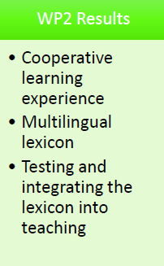
WP 2: Building a multilingual and visual
Latin lexicon

Slide 3
WP 2: Objectives
Specific objectives of WP2:
Facilitating the active learning of Latin vocabulary.
Supplementing the EULALIA Lexicon with translators from the students’ L1, with indications for correct pronunciation and pictures, to reinforce the multi-sensoriality of the EULALIA Lexicon.
Facilitating the learning of students with special needs.
Facilitating the learning for students who study Latin in a language other than their L1.

Slide 4
WP 2: Objectives
Specific objectives of WP2 are in line with the general objectives of the project:
Stimulating innovative learning practices: vocabulary will not be the object of mechanical memorisation, but the product of collaborative work; the association of images with words will make it possible to combine language learning with the study of ancient culture, with e.g. visits to local museums.
Multilingualism as a facilitator of inclusion in the field of Education for all learners, with a specific focus on learners with special needs and students who learn Latin in a language different from their L1.
Promoting EU values: particular attention will be paid to words associated with the pivotal values of European culture, like ius, humanitas, libertas, thus stimulating reflection on the relationship between past and present.

Slide 5
WP 2: Results
Creation of a Multilingual Lexicon through an extensive cooperative learning action, involving university and school students from the partner countries. The words of the EULALIA basic vocabulary will be accompanied by their translators in the languages of the partner countries. The words will also be accompanied by pronunciation clues, and, wherever possible, will be illustrated by images. Words related to EU values will be particularly highlighted.
Open access publication of the Lexicon on the IN-EULALIA website.
Promotion of the Lexicon in the Latin courses of the partner universities, especially among international students (e.g. ERASMUS) who speak the languages included in the Lexicon, and students with special needs, to whom specific testing activities will be addressed.

Slide 6
WP 2: Activities
A1) Preparation for cooperative learning: the partners make arrangements with the Latin teachers of their institution and/or local schools; agree with them on the activities to be carried out and the timetable; prepare the teaching materials; agree with museums or other institutions that own images to make them accessible and usable to participants in accordance with the laws.
A2) Cooperative learning experience: Coordinated by their reference partner, school and HE teachers and students in each country contribute to supplementing the EULALIA Lexicon with translations in their national language, annotations for pronunciation and images being preferably an expression of ancient culture; the images can be purchased online or onsite (e.g. by visiting local museums). Their acquisition must comply with the licences and rules regulating the circulation of images. The monitoring of this activity is carried out in Meeting 2.

Slide 7
WP 2: Activities
A3) Producing a Multilingual Lexicon: the partners review and select the materials collected by the students and produce a final version of the EULALIA Lexicon with translations into their language, annotations for pronunciation and images. UNIBO will publish it on the project website.
A4) Inclusive testing and piloting: the activity goes in parallel with A2 and A3, testing the activities carried out by each partner and addressed to the students involved in the cooperative learning and to students with special needs and non-mother-language. A4 also verifies to what extent cooperative learning facilitates the achievement of lexical competence as measured by Latin certification, and assesses the actual usefulness of the Multilingual vocabulary for students with special needs and non-mother-language. Moreover, A4 pilots the permanent integration of the Lexicon into the teaching of the partner universities. The results will be evaluated at the final meeting (Meeting 4).

Slide 8
WP 2: Partners’ tasks
USAL will provide the other partners with a protocol (A1) to effectively present the initiative and prepare the required teaching materials.
ULISB will follow the protocol provided by USAL and coordinate the other partners in the cooperative learning activity (A2). Each partner will start the production of materials, distribute the lexicon sections according to the competences of the students involved, guide the students in finding images (online and onsite) consistent with the ancient world, and provide guidance on the licences regulating the diffusion of the images.
USAL will monitor the activity in M2.

Slide 9
WP 2: Partners’ tasks
UR will coordinate the partners in the gradual revision of the materials and edit the Multilingual Lexicon (A3).
UNIBO will make the Lexicon available in open access on the project website (A3).
UNIBO will coordinate the testing activities carried out by each partner on the students who participate in cooperative learning (A4). UNIBO will also supervise the timetable of the individual working groups and offer specific activities for non-native students and those with special needs. These groups will participate in the testing according to the policies of each partner’s institution. UNIBO will present the results of this activity at M4.

Slide 10
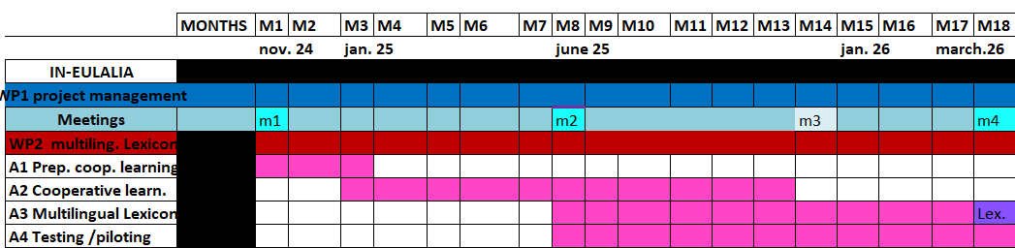
WP 2: Timetable

Slide 11
WP 2: Overview
ACTIVITY | LEADING PARTNER | START | END | RESULTS
A1 Preparation for cooperative learning | USAL | 04/11/24 | 31/01/25 | Agreements with institutions, preparation of activities and materials
A2 Cooperative learning | ULISB | 01/02/25 | 30/11/25 | Collection of the materials; translations, images MONITORING in M2: Lisbon, June 2025
A3 Multilingual Lexicon | UR | 02/06/25 | 31/03/26 | Production and OA publication of the Lexicon
A4 Testing and piloting of the Lexicon | UNIBO | 02/06/25 | 31/03/26 | Testing of the Lexicon and piloting among the partners MONITORING in M4: Salamanca, March 2026
WP2 FINAL EVENT (E1): SALAMANCA, MARCH 2026

Slide 12
WP 2: To-do list Dec 2024 – Jan 2025 (A1)
By January – ALL PARTNERS:
Activate contacts for cooperative learning involving students and teachers internal to our institutions and external, e.g. from schools or other universities.
Organise the work and distribute the tasks inside the unit.
Prepare protocols and indications, e.g. sources to be used to find translators, indications on where to find images; take contacts with local institutions like museums, etc.
By mid-December – UNIBO:
Provides indications for the collection and use of images respecting privacy and copyright.
By mid-December – UNISAL:
Provides the partners with a vademecum (protocol) on the starting of the activity (involvement of schools, preparation of materials, identification of online and onsite image collections).

Slide 13
Some guidelines on the collection of images
Images must not depict persons or contain references to personal data, i.e. information that can be traced to a person directly or indirectly.
Each partner takes responsibility for collecting the images in a transparent and fair manner, and in particular:
they collect permissions from students or parents, if under age, with which the author of the photo authorises the use of the images;
they collect the information necessary for proper publication (e.g. author’s name, provenance) and obtain the authorisation of the institution owning the photographed object;
they make sure that any existing images are in open access.
The partners will collect this documentation in agreement with their administrations and then issue UNIBO with a document in which they guarantee the correctness of the work carried out and release UNIBO from liability for incorrectly collecting the images (UNIBO will provide this form).

Slide 14
WP 2: Expected participants
Latin teachers from partner schools and universities directly involved in the cooperative learning: 20
HE and school students involved in the cooperative learning and final testing: 120
Decision makers, e.g. representatives of classical culture associations, local, regional and national school offices, associations dealing with teacher training or special needs, who will be involved in internal (excluding E1) and external dissemination events, including the presentation of the Lexicon: 20
Students and teachers from schools and universities to be involved in internal (excluding E1) and external dissemination events: 180
People involved in E1 (school and university teachers, stakeholders, local, regional and national school offices, decision makers, associations dealing with teacher training or special needs): 50

Slide 15
WP 2: Indicators
Quantitative indicators:
Number of Latin courses of partners integrating the Lexicon into their teaching practice: 10
Number of schools involved in the cooperative learning: 10
Number of HE and school students who will have passed the certification tests based on Lexicon: 100
Number of international (e.g. Erasmus) and/or special needs students who specifically experience the Lexicon: 20
Number of presentations of the Lexicon on media and social media: 4

Slide 16
WP 2: Indicators
Qualitative indicators (from questionnaires administered to participants during the activities – positive evaluation with at least 75% positive ratings):
Evaluation from universities and schools who participated in the cooperative learning
Evaluation of the cooperative learning experience by the teachers of the participating schools
Evaluation of the Lexicon by the participants in dissemination events (except E1)
Evaluation of the Lexicon by E1 participants
Evaluation of the Lexicon by international (e.g. ERASMUS) and/or by special needs students
Evaluation of the Lexicon by LTT participants
Positive feedback on media and social media presentations.

Slide 17
UNIBO Team
Dipartimento di Filologia Classica e Italianistica
lucia.pasetti@unibo.it
elisa.dalchiele3@unibo.it
chiara.gianollo@unibo.it
francesca.magrefi@unibo.it
stefania.pollastri3@unibo.it
tommaso.ricchieri@unibo.it
chiara.valenzano@unibo.it

