Slide 1
Public Goals and Private Duties in the Corporate Sustainability Due Diligence Directive
Michele Corgatelli (LLM by Research, University of Glasgow)
Ph.D. Student in Legal Studies, University of Bologna
Visiting Student, European University Institute

Slide 2
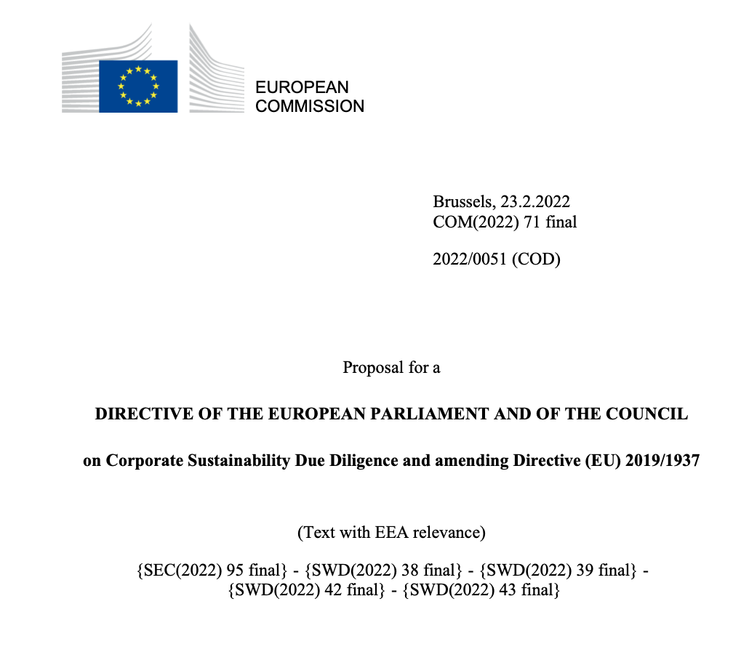

Slide 5
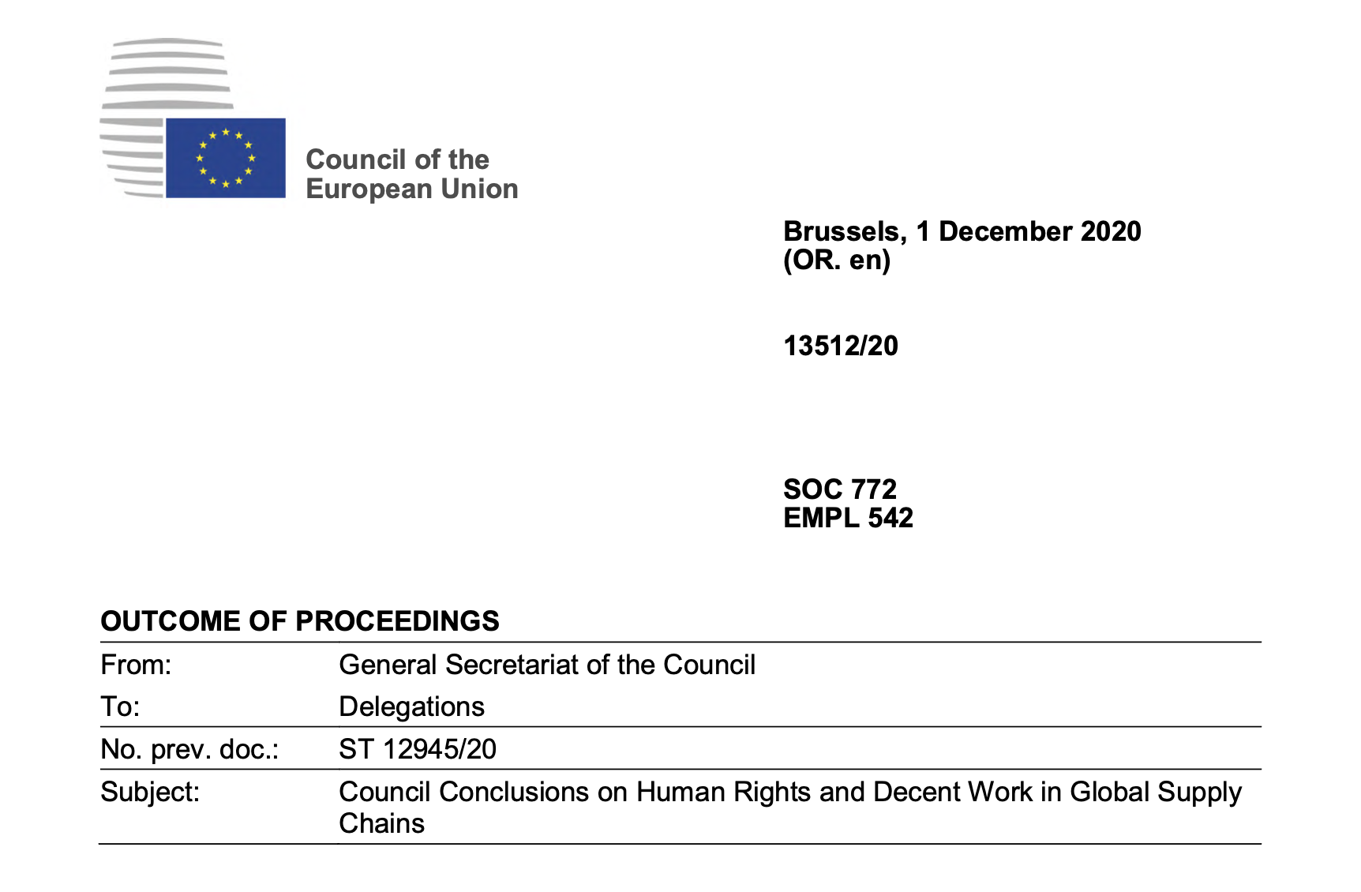

Slide 6
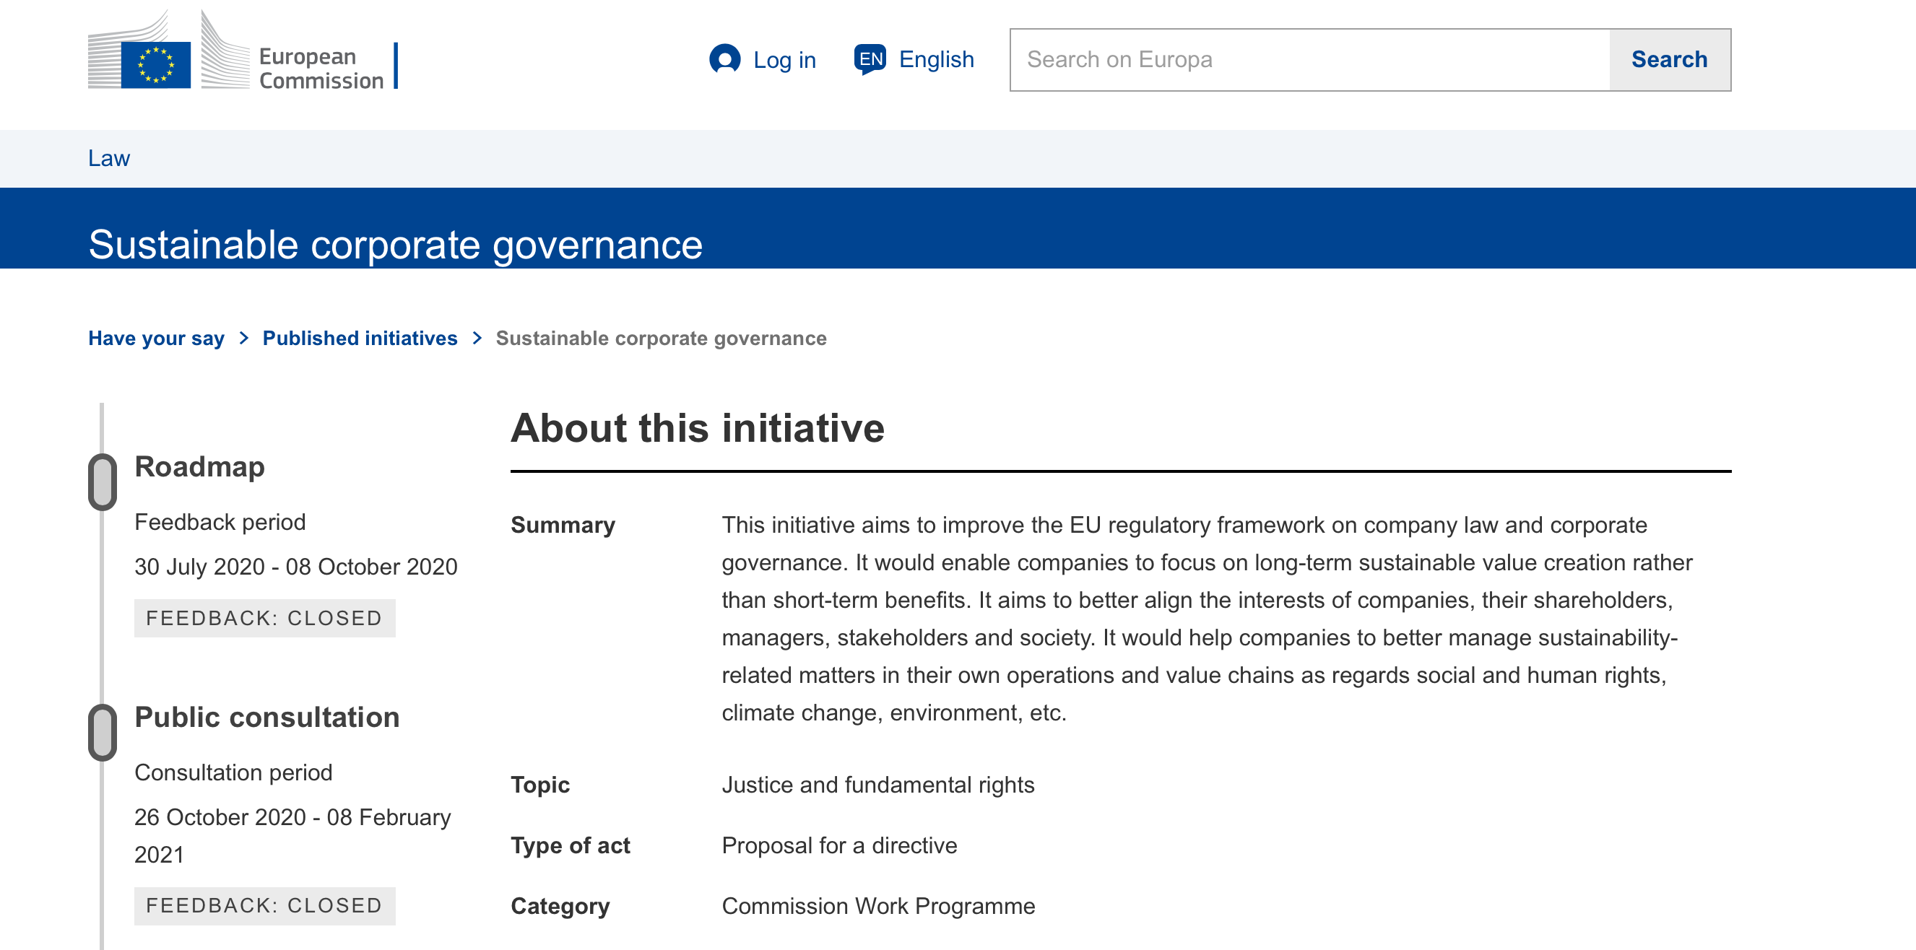

Slide 8
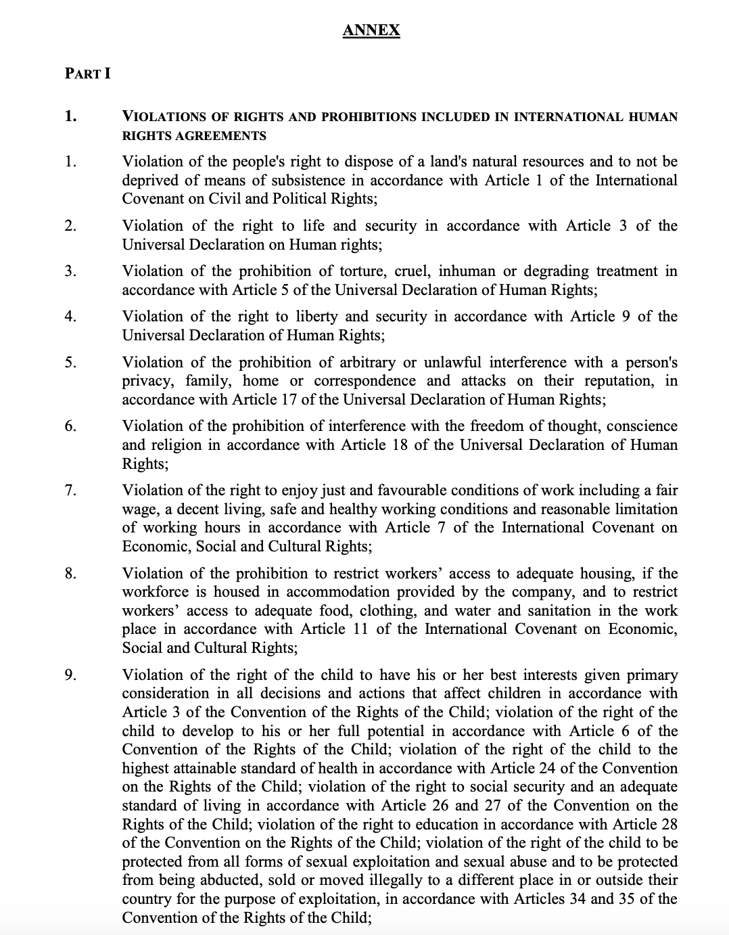

Slide 9
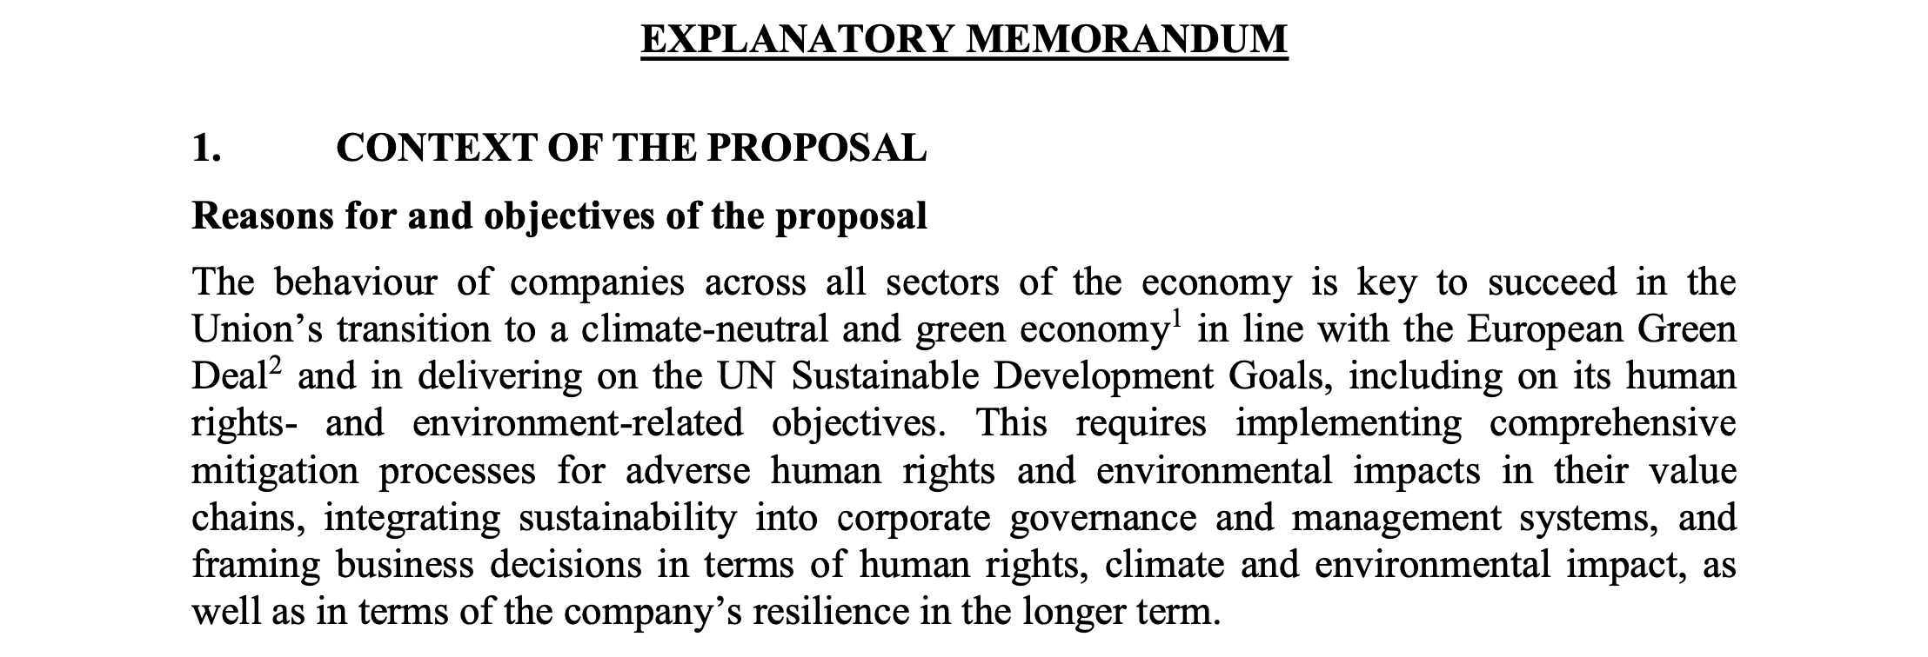
Corporate governance implications

Slide 10
This paper aims at:
Providing context to corporate law scholars
Assessing the integration of public goals (set jointly by State actors) into the private duties of EU large companies
Exploring the implications of this integration on the interpretation of the legal text

Slide 11
Context
California Transparency in Supply Chains Act
French Duty of Vigilance Law
Dutch Responsible and Sustainable International Business Conduct Act
Norwegian Supply Chain Transparency Act
German Supply Chain Due Diligence Act
Modern Slavery Act (UK, Australia, Canada)
Dodd-Frank Wall Street Reform and Consumer Protection Act
Regulation (EU) 2017/821
Scope of application
Social v. environmental aspect
Procedures established
Enforcement (public v. private)

Slide 13
Four level of integration of public goals into private duties
International standards
UN Sustainable Goals
Paris Agreement
International Treaties listed in the Annex

Slide 14
International standards

Slide 15
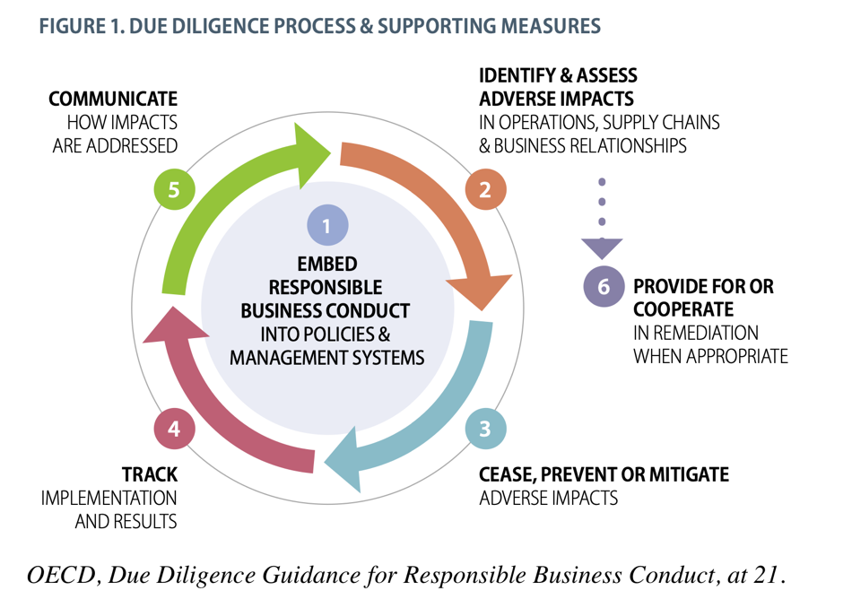

Slide 16
CSDDD:
adoption of due diligence policies
identification of actual and potential adverse human rights and environmental impacts
prevention
contrast to actual adverse impacts
complaints procedures
monitoring
communication

Slide 17
UN Sustainable Goals & Paris Agreement

Slide 18
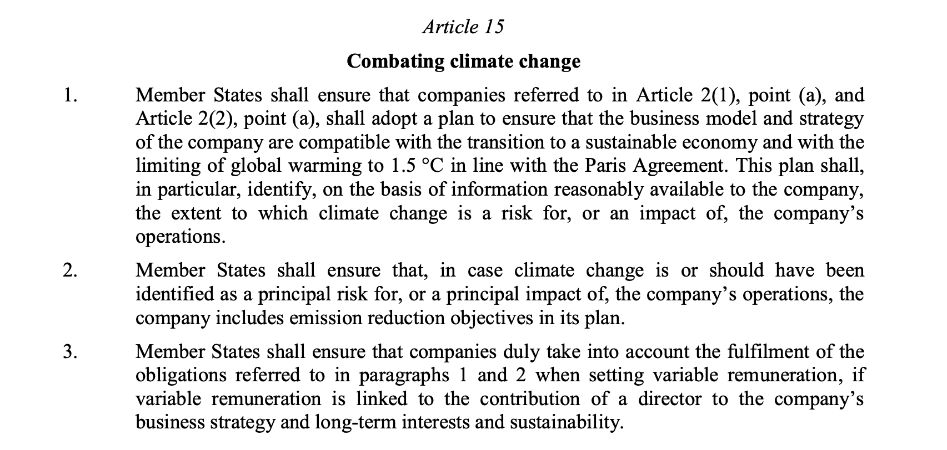

Slide 20
CSDDD:
no poverty (n. 1)
good health and well-being (n. 3)
gender equality (n. 5)
clean water and sanitation (n. 6)
decent work and economic growth (n. 8)
industry, innovation and infrastructure (n. 9)
reduced inequalities (n. 10)
peace, justice and strong institutions (n. 16)
target n. 12.6 mentions the encouragement of sustainable corporate practices
goal n. 17 designates a role for businesses in assisting governments in addressing the other state-centred Goals

Slide 21
An impossible goal?
Art. 30 of the European Commission’s proposal: the deadline for the transposition of the Directive is set at 2 years from the day of its entry into force
Member States shall apply the provisions from 2 or 4 years from its entry into force on the basis of different thresholds related to the companies’ size
The prevention and mitigation of potential adverse impacts through preventive action plans will require consultations with affected stakeholders (Art. 7)

Slide 22
International Treaties listed in the Annex

Slide 23
Implications of the shift towards corporate sustainability due diligence
The origins of the initiative are key to the interpretation of this legal text
Business lawyers are familiar with the concept of due diligence
≠ business due diligence
Overview of third parties’ conduct
Impacts (double materiality principle)
Risk management (= prevention of externalities)
Costs
Enforcement (public v. private)
Extra-territorial effects (global value chains)
International treaties (how can companies contribute?)

Slide 24
Thank you!
michele.corgatelli@unibo.it
https://www.unibo.it/sitoweb/michele.corgatelli/en

