Slide 1

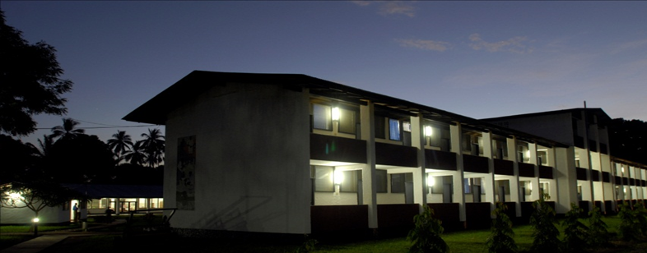
TANZANIAN TRAINING CENTRE FOR INTERNATIONAL HEALTH
Your partner in health training

Slide 2
The Ifakara Cluster, a Unique Collaboration
TTCIH
SFUCHAS
Training in health,
Clinical services,
Research
EMIC
IHI
SFRRH
SolidarMed
GSCH
Notes:
2

Slide 3


TTCIH History

Slide 4
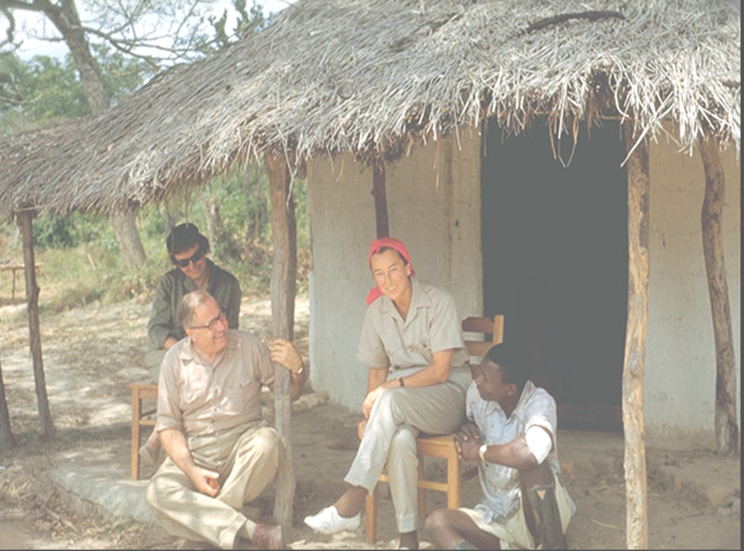
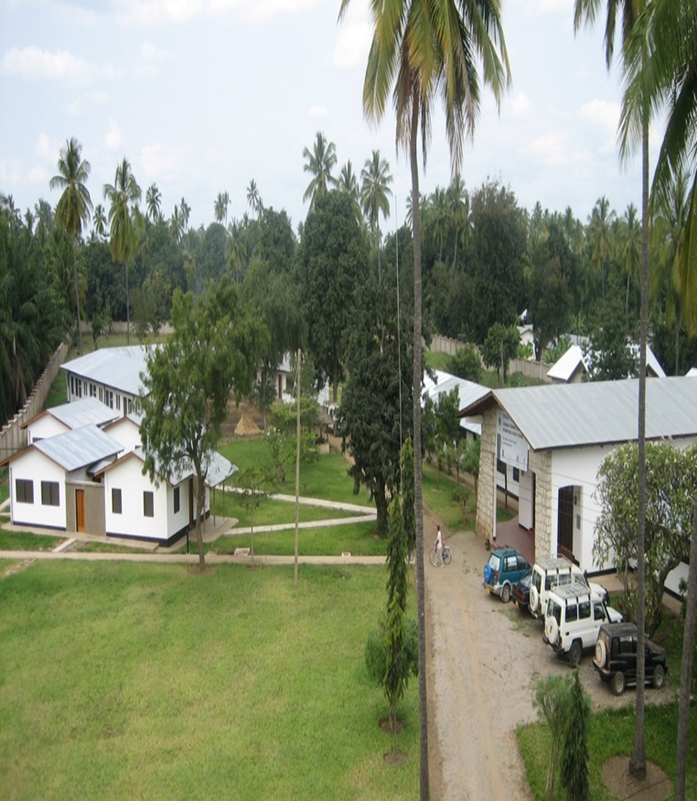
TTCIH History
1961
Rural Aid Centre
~ Basel Foundation
1973
Medical Assistant Training Centre (MATC)
~ Basel Foundation
1994
Clinical Officer Training Centre
~ Public leadership
2006
Officially made PPP (AMOs)
~ TTCIH inaugurated!

Slide 5
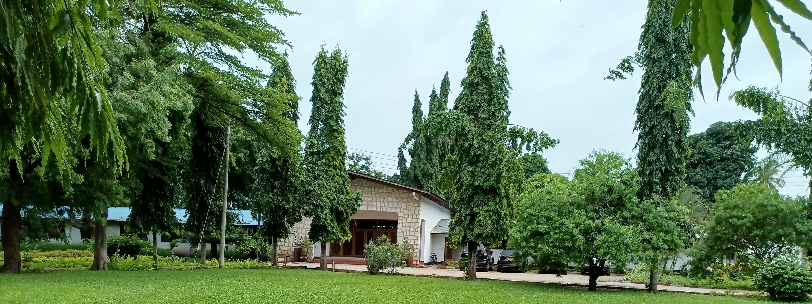
TTCIH History
2016
Diploma in Clinical Medicine re-started
2019
Advanced Diploma in Clinical
Medicine training paused
2023
Diploma in Pharmaceutical Sciences
and
Diploma in Optometry started

Slide 6

Vision and Mision Statements
Vision:
To become a centre of excellence in innovative health training and health system strengthening at national and international levels
Mission:
To offer quality health training programs and consultancy services, conduct health research and to manage projects addressing the needs of front-line health services and health workers

Slide 7
Expertise
Academic (24):
Clinical medicine (10)
Pharmaceutical sciences (8)
Eye health (4)
Nursing and midwifery (1)
Public health (1)
Support (17):
5 tutors = ICT (2), information studies (1), finance and accountancy (2)
12 = others
41 Staff
Training of health care workers (2025-26 academic year = 406 students)
Curricula reviews and development
National eLearning Platform
Research projects (Familia Nawiri, AMPS, MHC, CBC, ASDIT, RUM, ICATT, TB-PCT etc)

Slide 8
BRIDGE Project: Roles and Expectations
Co-establishment and governance of Ifakara hub
Training and capacity building:
Co-develop training modules
Co-deliver CPD courses in blended mode
Participate in academic and administrative staff training workshops
Digital learning and MOOC development:
Co-develop MOOC platform
Co-manage the digital learning infrastructure
Integrate learning management systems
Project management and governance:
Management Board
Quality Assurance Team
Work Package implementation
Reporting and monitoring

Slide 9
Asante Sana!

