Slide 2


FROM 1088 TO THE FUTURE
THE BIRTH OF THE UNIVERSITY
ONE CITY,
MANY NATIONS
FROM BOLOGNA TO THE WORLD, FROM THE WORLD TO BOLOGNA
XII CENTURY
XIV-XV CENTURIES
1088
XIII CENTURY
XVI-XVII CENTURIES
FREEDOM OF RESEARCH
BROADENING THE HORIZONS OF KNOWLEDGE
THE MOTHER OF
ALL UNIVERSITIES
AN INTERNATIONAL AGREEMENT
THE UNIVERSITY LOOKS TO THE FUTURE
XX CENTURY
1999
2019
1888
1988
2016
NEW CHALLENGES
1999 BOLOGNA
PROCESS
20th ANNIVERSARY OF THE BOLOGNA PROCESS

Slide 3
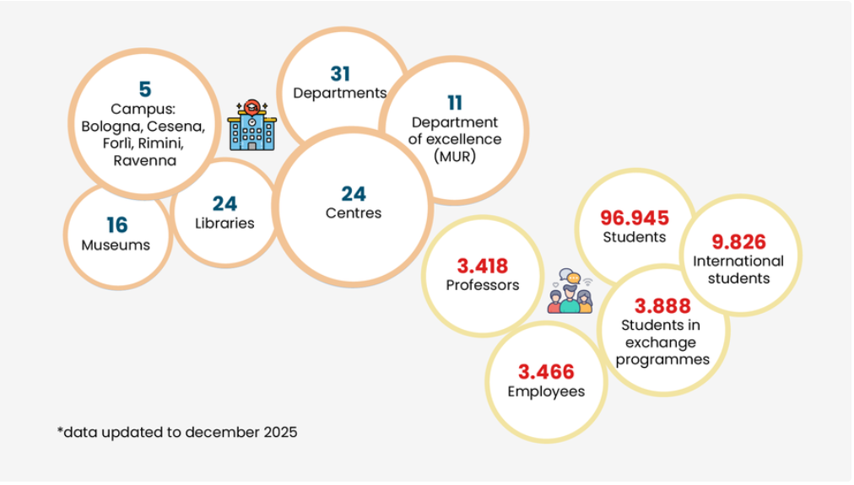
UNIBO in figures

Slide 4
MULTICAMPUS
CESENA CAMPUS
FORLÌ CAMPUS
RAVENNA CAMPUS
RIMINI CAMPUS
The main vocations
The main vocations
The main vocations
The main vocations
AGRIFOOD
ARCHITECTURE
ICT AND BIOENGINEERING
ECONOMICS AND SOCIAL SCIENCES
MECHANICAL AND
AEROSPACE ENGINEERING
TRANSLATION AND
INTERPRETING
ENVIRONMENTS
AND SEA
RIGHTS
CULTURAL HERITAGE
SUSTAINABLE DEVELOPMENT
AND WELL BEING
SERVICES FOR INDIVIDUALS, BUSINESSES AND COMMUNITIES
TOURISM AND FASHION

Slide 5
31 DEPARTMENTS
Medicine
Biomedical and Neuromotor Sciences
Medical and Surgical Sciences
Veterinary Medical Sciences
Science
Chemistry “Giacomo Ciamician”
Industrial Chemistry “Toso Montanari”
Pharmacy and Biotechnology
Physics and Astronomy “Augusto Righi”
Mathematics
Biological, Geological and
Environmental Sciences
Life Quality Studies
Technology
Architecture
Computer Science and Engineering
Civil, Chemical, Environmental and Materials Engineering
Electrical, Electronic and Information Engineering “Guglielmo Marconi”
Industrial Engineering
Agricultural and Food Sciences
Humanities
The Arts
Classical Philology and Italian Studies
Philosophy
Modern Languages, Literatures and Culture
Psychology “Renzo Canestrari”
Education Studies “Giovanni Maria Bertin”
History and Cultures
Cultural Heritage
Interpreting and Translation
Social Studies
Management
Economics
Legal Studies
Political and Social Sciences
Statistical Sciences “Paolo Fortunati”
Sociology and Business Law

Slide 6


RESEARCH
OUTSTANDING MULTIDISCIPLINARY RESEARCH

Slide 7
COMPETITIVE PROGRAMMES
EUROPEAN PROGRAMMES
> 84 mln € HORIZON EUROPE (2021 - 2027)
KIC (2023): > 600 thousand €; 7 projects funded
Other European calls for proposals: >5 million euros;
37 funded projects, of which 18 coordinated
177 projects signed: 60 coordinated,
12 of which are ERC
> 150 mln € HORIZON 2020 (2014 - 2020)
> 8 mln € JOINT INITIATIVES
350 projects funded: 98 coordinated,
26 of which are ERC
3.000 partner involved, 1.600 of which are private
First Italian university for contributions obtained on the pillar dedicated to social challenges
JPI (2013-2023): > 1,5 mln €; 15 projects funded,
1 of which as coordinator
ERANET (2014-2023): > 3 mln €; 28 projects funded,
4 of which as coordinator
PRIMA (2018-2023): >2,5 mln €; 12 projects funded,
4 of which as coordinator
EJP (2021) > 100 thousand €; 1 project funded
as partner
Co-founded European Partnerships (2022-2023):
500 thousand €, 4 projects funded as partner
> 17 mln € OTHER EUROPEAN FUNDING
INTERREG: > 6 mln €; 30 projects fundend,
6 of which as coordinator
LIFE: > 6 mln €; 17 projects funded,
6 of which as coordinator

Slide 8
COMPETITIVE PROGRAMMES
NATIONAL PROGRAMMES
REGIONAL AND LOCAL PROGRAMMES
> 38 mln €:
PRIN 2022: 515 funded projects, of which 191 as members of the Alma Mater in the role of national coordinators
> 15 mln €:
PRIN 2022 PNRR: 161 funded projects, of which 68 as members of the Alma Mater in the role of national coordinators
> 9,5 mln €:
PRIN 2020: 62 funded projects, of which 22 as members of the Alma Mater in the role of national coordinators
> 8 mln € OTHER NATIONAL FUNDING
PON RESEARCH AND INNOVATION: > 2,6 mln €; 13 funded projects
FISR: > 1,3 mln €; 14 funded projects
Rita Levi Montalcini Programme: > 2 mln €; 10 funded projects
FARE: > 2 milioni di euro; 11 funded projects
> 51 mln €
POR-FESR (2014-2020): 23 mln €, 80 projects funded
PSR (2014-2020): 4,5 mln €, 83 projects funded
PR-FESR Emilia Romagna (2021-2027): 10 mln €,
59 funded projects
Advanced Skills (2016-2021): 7,3 mln €, 147 projects funded
Funding from Foundations (2017-2023): 5 mln €, 188 projects funded, 137 of which coordinated
Other regional and local projects: 1 mln €,
18 funded projects

Slide 9
INDUSTRIAL RELATIONS
44 ACTIVE FRAMEWORK AGREEMENTS with major companies in the main sectors
7 ACTIVE FRAMEWORK AGREEMENTS with some of the main business associations
6 JOINT RESEARCH LABORATORIES with industries
4 ADVANCED VOCATIONAL TRAINING SCHOOLS for employees of companies
1 COMPETENCE CENTER in the context of the National Industry Plan 4.0. BI-REX
PLACEMENT SERVICES. In 2023 almost 9,400 Italian and international companies published more
than 5,000 job offers on the online noticeboard
58 COMPANIES (SPIN-OFFS AND STARTUPS) established and accredited in 2022
BUSINESS INCUBATION AND DEVELOPMENT Almacube, Behold srl, Cesenalab,
Innovation Square, Basement Club

Slide 10
SOCIAL ENGAGEMENT, COOPERATION AND DEVELOPMENT
“Italian Support for University Education in Somalia”, initiative financed by AICS
8 projects funded by the Italian Agency for Development Cooperation within the framework of programs for Civil Society Organizations
7 NGO projects funded by the Emilia-Romagna Region for decentralized cooperation
3 “Intra-Africa mobility” European projects
10 international development cooperation initiatives in Africa, South America and Asia funded by UNIBO under UNIBO Global South Program
The University is currently involved in:
13 Erasmus Plus Capacity Building Higher Education projects
1 Erasmus Plus Capacity Building Youth project
1 Erasmus Plus Capacity Building VET project
2 projects funded by the DG International Partnerships of the European Commission
3 recent training and technical assistance initiatives with a coordinating role and funded by the Italian Agency for Development Cooperation (AICS)
UNIBO4REFUGEES E UNI-CO-RE (UNIVERSITY CORRIDORS FOR REFUGEES – ETHIOPIA – UNIBO)

Slide 11








www.unibo.it

