Slide 1


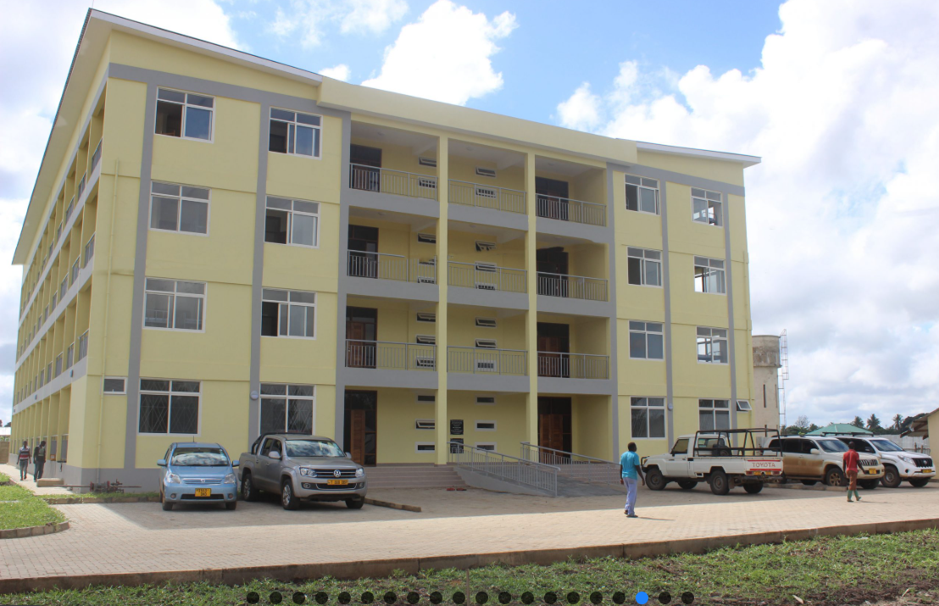
SFUCHAS
Key Participants
Prof. Pemba Senga –Local PI
Prof. Albino Kalolo – Senior Researcher and Principal
Dr. Claus Thomas-LEAR, DRPCS
CPA. Novati Ludovick- Finance Manager
Ms. Mariam Chale- ICT manager

Slide 2
Establishment of SFUCHAS
SFUCHAS was established in October 2010 in Ifakara, Kilombero District Morogoro region.
It operates as a constituent college of St. Augustine University of Tanzania.
The university was established to address the shortage of health professionals with a special focus is to improving health in rural communities.

Slide 3
Vision and Mission
Vision: To be an outstanding Catholic university in health training and research.
Mission: To train competent health professionals with strong ethical values.

Slide 4
The Ifakara Cluster
SFUCHAS is surrounded by important health and research institutions.
These include IHI, SFRRH, TTCIH, SOLIDAR MED, EMIC, GSCH, IIH and NLC.
SFRRH serves as the main teaching hospital.
This environment creates strong opportunities for training and research.

Slide 5
Students and Academic Programs
SFUCHAS currently hosts more than 1,600 students.
Programs include Doctor of Medicine (MD).
Diploma programs include Medical Laboratory Sciences and Pharmaceutical Sciences.
New undergraduate and Postgraduate programs to be established in the future

Slide 6
Diversification of Expertise
SFUCHAS has experts from different health fields
These include professors, lecturers, researchers, and clinicians.
Specialties include medicine, laboratory sciences, pharmacy, social sciences and public health.
Professionals work together in teaching, research, and clinical practice.

Slide 7
ROLE AND EXPECTATIONS IN THE BRIDGE
Build and manage the hybrid learning hub- (Rular hub)
Deliver selected training programs to the healthcare workers and faculty through LMS
Handle procurement and finances of the allocated budget
Conduct research
Provide Reports
Closely collaborate with project partners (Primary and Associate), more closely with TTCIH (Rural hub partner)
Ensure sustainability and long-term impact of the project

